Slide 1
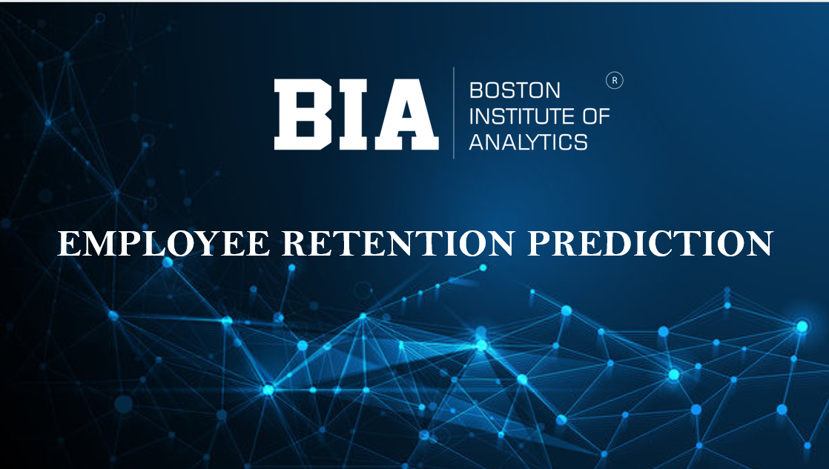

Slide 2



Employee Retention
Prediction Analysis
“In the era of data-driven workforce management, this project focuses on developing machine learning models to predict employee job change behavior. By analyzing various employee-related factors, the model helps organizations identify potential attrition risks and implement effective strategies to improve employee retention and workforce stability.”
Presented By: Priyanshu Sahoo

Slide 3







05
FEATURE ENGINEERING
01
Introduction
02
Data Collection & Refinement
06
TRAIN TEST SPLIT
03
Exploratory Data Analysis (EDA)
07
HANDLING IMBALANCED DATA (SMOTE)
04
PREPROCESSING
08
PREDICTION, CONCLUSION & FUTURE RESEARCH

Slide 4

INTRODUCTION
• Employee Retention Prediction uses machine learning techniques to identify whether employees are likely to stay or leave an organization. High turnover leads to increased costs, loss of talent, and reduced productivity.
• The dataset includes key factors such as employee demographics, job role, salary, performance, and training history, with retention (attrition status) as the target variable.
• This project aims to build a predictive model using techniques like data preprocessing, feature engineering, and algorithms such as Logistic Regression, Random Forest, XGBoost, and LightGBM.
• The model helps organizations improve retention strategies, plan recruitment effectively, and make data-driven decisions, supported by visualizations and performance evaluation metrics.

Slide 5



OBJECTIVE OF THE STUDY
VALUE OF THE STUDY
Employee Risk Stratification → High-Risk Employee Identification
Comparing Machine Learning Algorithms → Model Performance Comparison
Real-Time Monitoring → Continuous Employee Behavior Tracking
Early Detection and Prevention → Proactive Attrition Prevention
Improved Employee Satisfaction and Retention → Enhanced Employee Engagement & Retention
Organizational Growth and Stability → Sustainable Workforce Growth

Slide 6
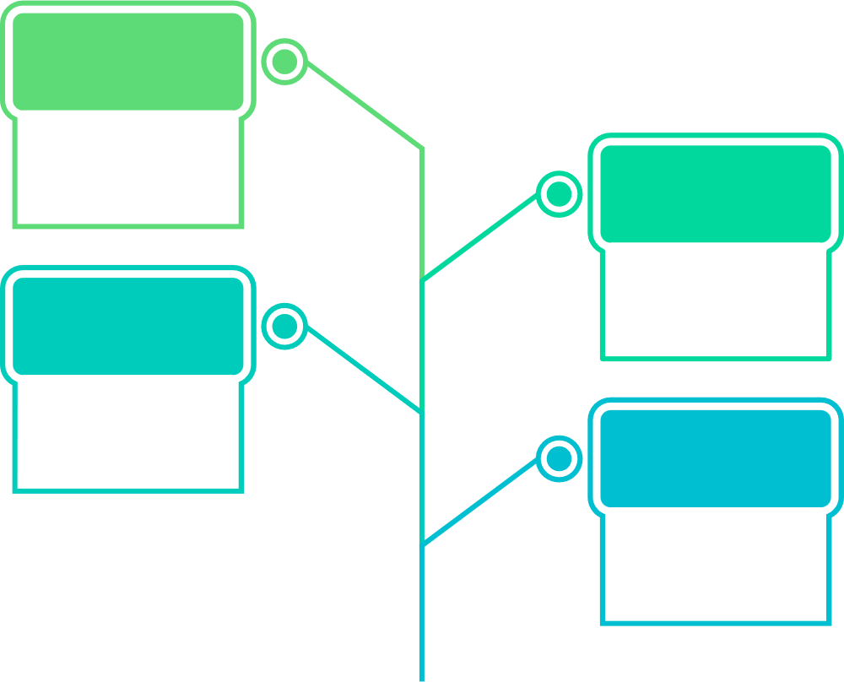
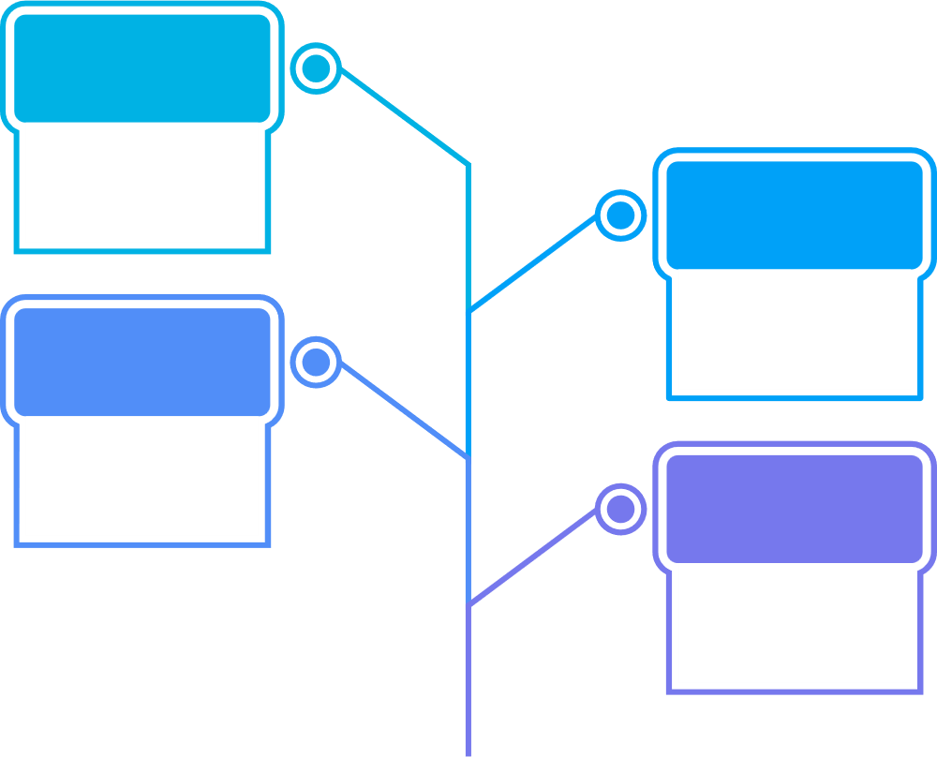
WORKFLOW
Conclusion
STEP
Summarizing insights for business impact, and future improvements
0 8
STEP
Prediction
0 7
Making predictions to monitor the model performance and to achieve Goal.
Model Training & Evaluation
STEP
Training multiple machine learning models and evaluating performance
0 6
STEP
Train-Test Split & Balancing
0 5
Splitting data and handling imbalance (SMOTE)
Feature Engineering
STEP
Creating and transforming features to improve model performance
0 4
STEP
Data Preprocessing
0 3
Cleaning and preparing data for modeling
Exploratory Data Analysis(EDA)
STEP
Analyzing and visualizing data patterns and relationships
0 2
Data Collection & Loading
STEP
Gathering, importing, and inspecting the dataset
0 1

Slide 7
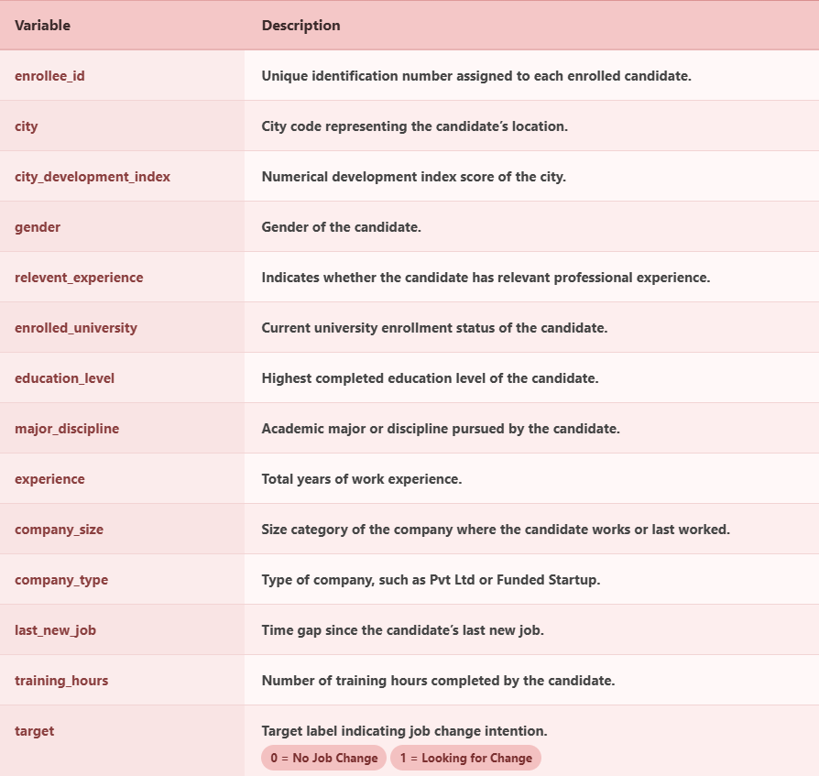
Data Collection & Refinement
Dataset Overview:
Dataset: aug_train.csv
Rows: 19,158
Columns: 14 Variables
X → Input Features (All Variables)
Demographic: City, City Development Index, Gender
Education: Relevant Experience, Enrolled University, Education Level, Major Discipline
Professional: Experience, Company Size, Company Type, Last New Job
Other: Training Hours, Enrollee ID (Identifier – not used for modeling)
Y → Output (Target Variable)
Target: Job Change
0 → No Job Change
1 → Looking for Job Change
Type: Binary Classification

Slide 8
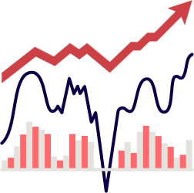
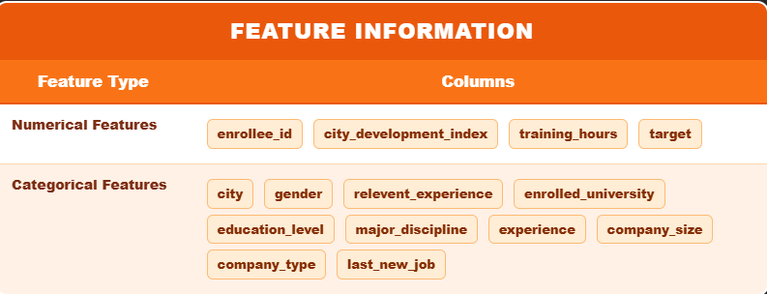
Exploratory Data Analysis(EDA)
• EDA helps in understanding the dataset structure, identifying patterns, trends, and extracting meaningful insights from employee data.
• Both numerical and categorical features are analyzed to understand their distributions and relationships with each other.
• Visualizations such as histograms, bar plots, and heatmaps are used to clearly understand feature behavior and key influencing factors.
• The dataset contains missing values (in features like gender, company_size, and company_type), along with duplicate values and outliers.
• Univariate and bivariate analysis are performed to study individual features and their relationship with the target variable (job change).
• EDA helps identify important features like city development index, experience, and relevant experience, improving model performance.

Slide 9
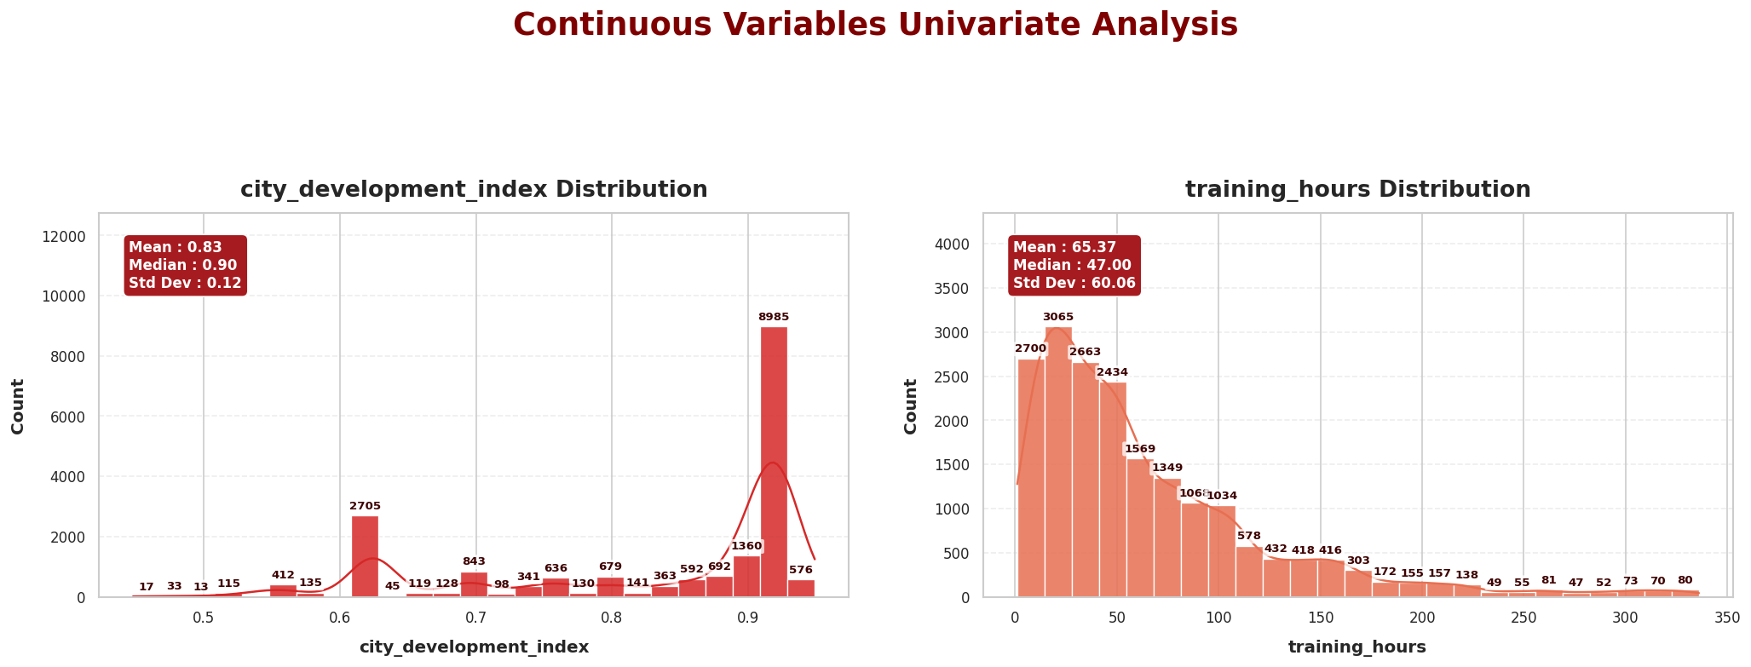
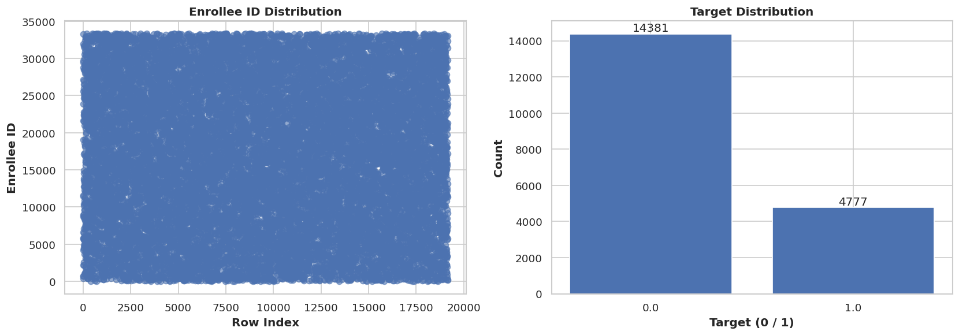
NUMERICAL VARIABLES — UNIVARIATE ANALYSIS
• City Development Index: Mostly high values (~0.9) → candidates from developed cities
• Training Hours: Most values are low (0–60) → few high values (right-skewed)
• Enrollee ID: Random distribution → no meaningful pattern (only identifier)
• Target: Imbalanced → more 0 (no job change) than 1

Slide 10
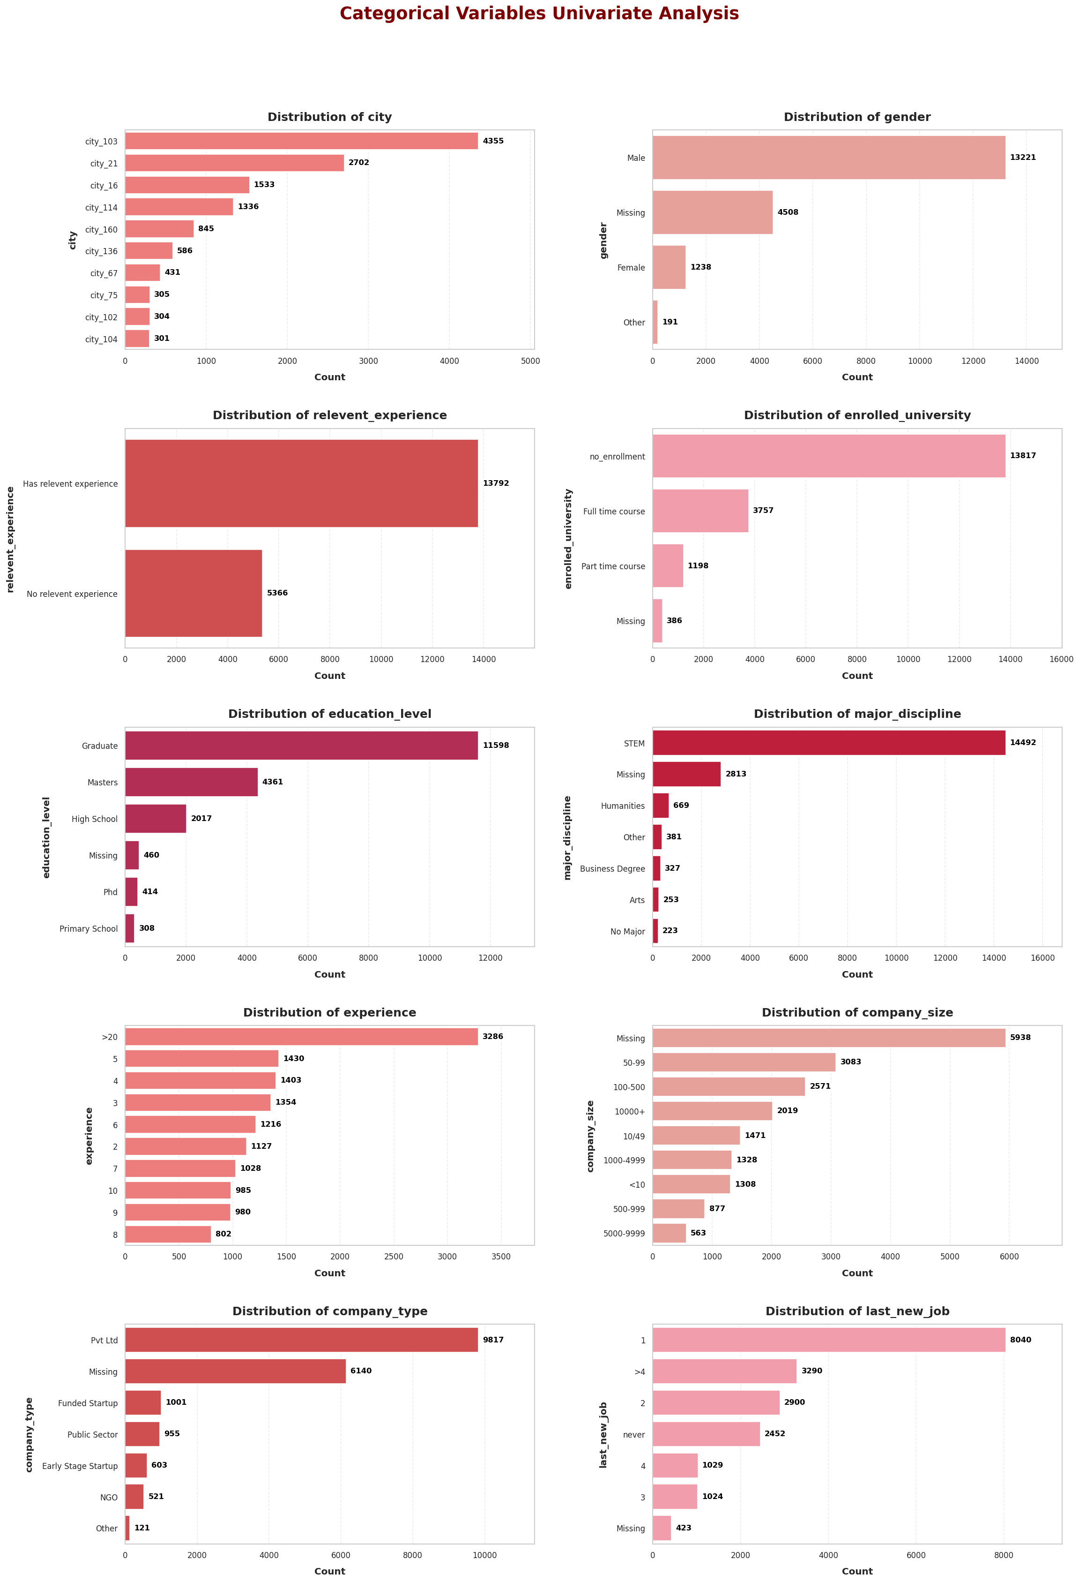
CATEGORICAL VARIABLES — UNIVARIATE ANALYSIS
• City: Few cities like city_103 and city_21 have highest candidates → data concentrated
• Gender: Mostly Male → dataset is imbalanced + some missing values
• Relevant Experience: Most candidates have relevant experience
• Enrolled University: Majority are not enrolled → working professionals
• Education Level: Most are Graduates, then Masters → strong education background
• Major Discipline: STEM dominates → technical field majority
• Experience: Many candidates have high experience (>20 years)
• Company Size: Many missing values → common sizes are 50–99 and 100–500
• Company Type: Pvt Ltd dominates → few startups and others
• Last New Job: Most changed job recently (1 year)

Slide 11
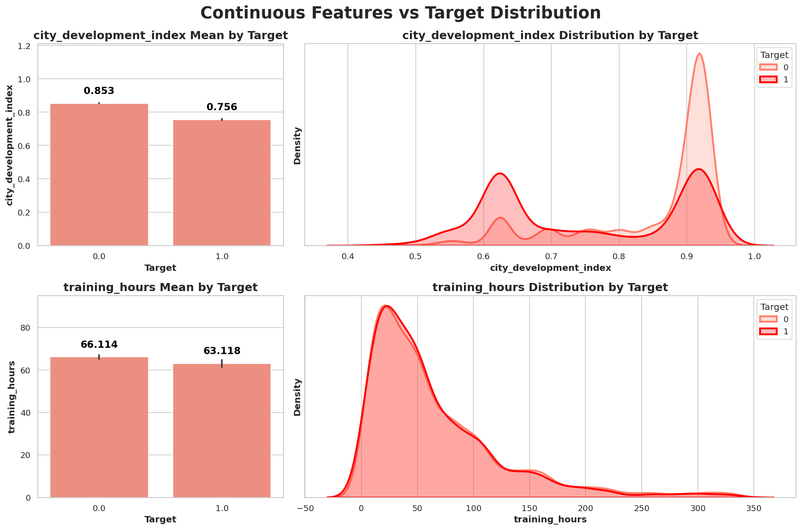
CONTINUOUS FEATURES VS TARGET
• City Development Index: Higher for target = 0 → strong relation with job stability
• Lower values of city index are linked with higher job change (target = 1)
• Training Hours: Similar for both target classes → weak relationship
• Both groups show right-skewed distribution in training hours
• Target is used to compare feature behavior across classes
• Enrollee ID is excluded → no meaningful relation (only identifier)

Slide 12
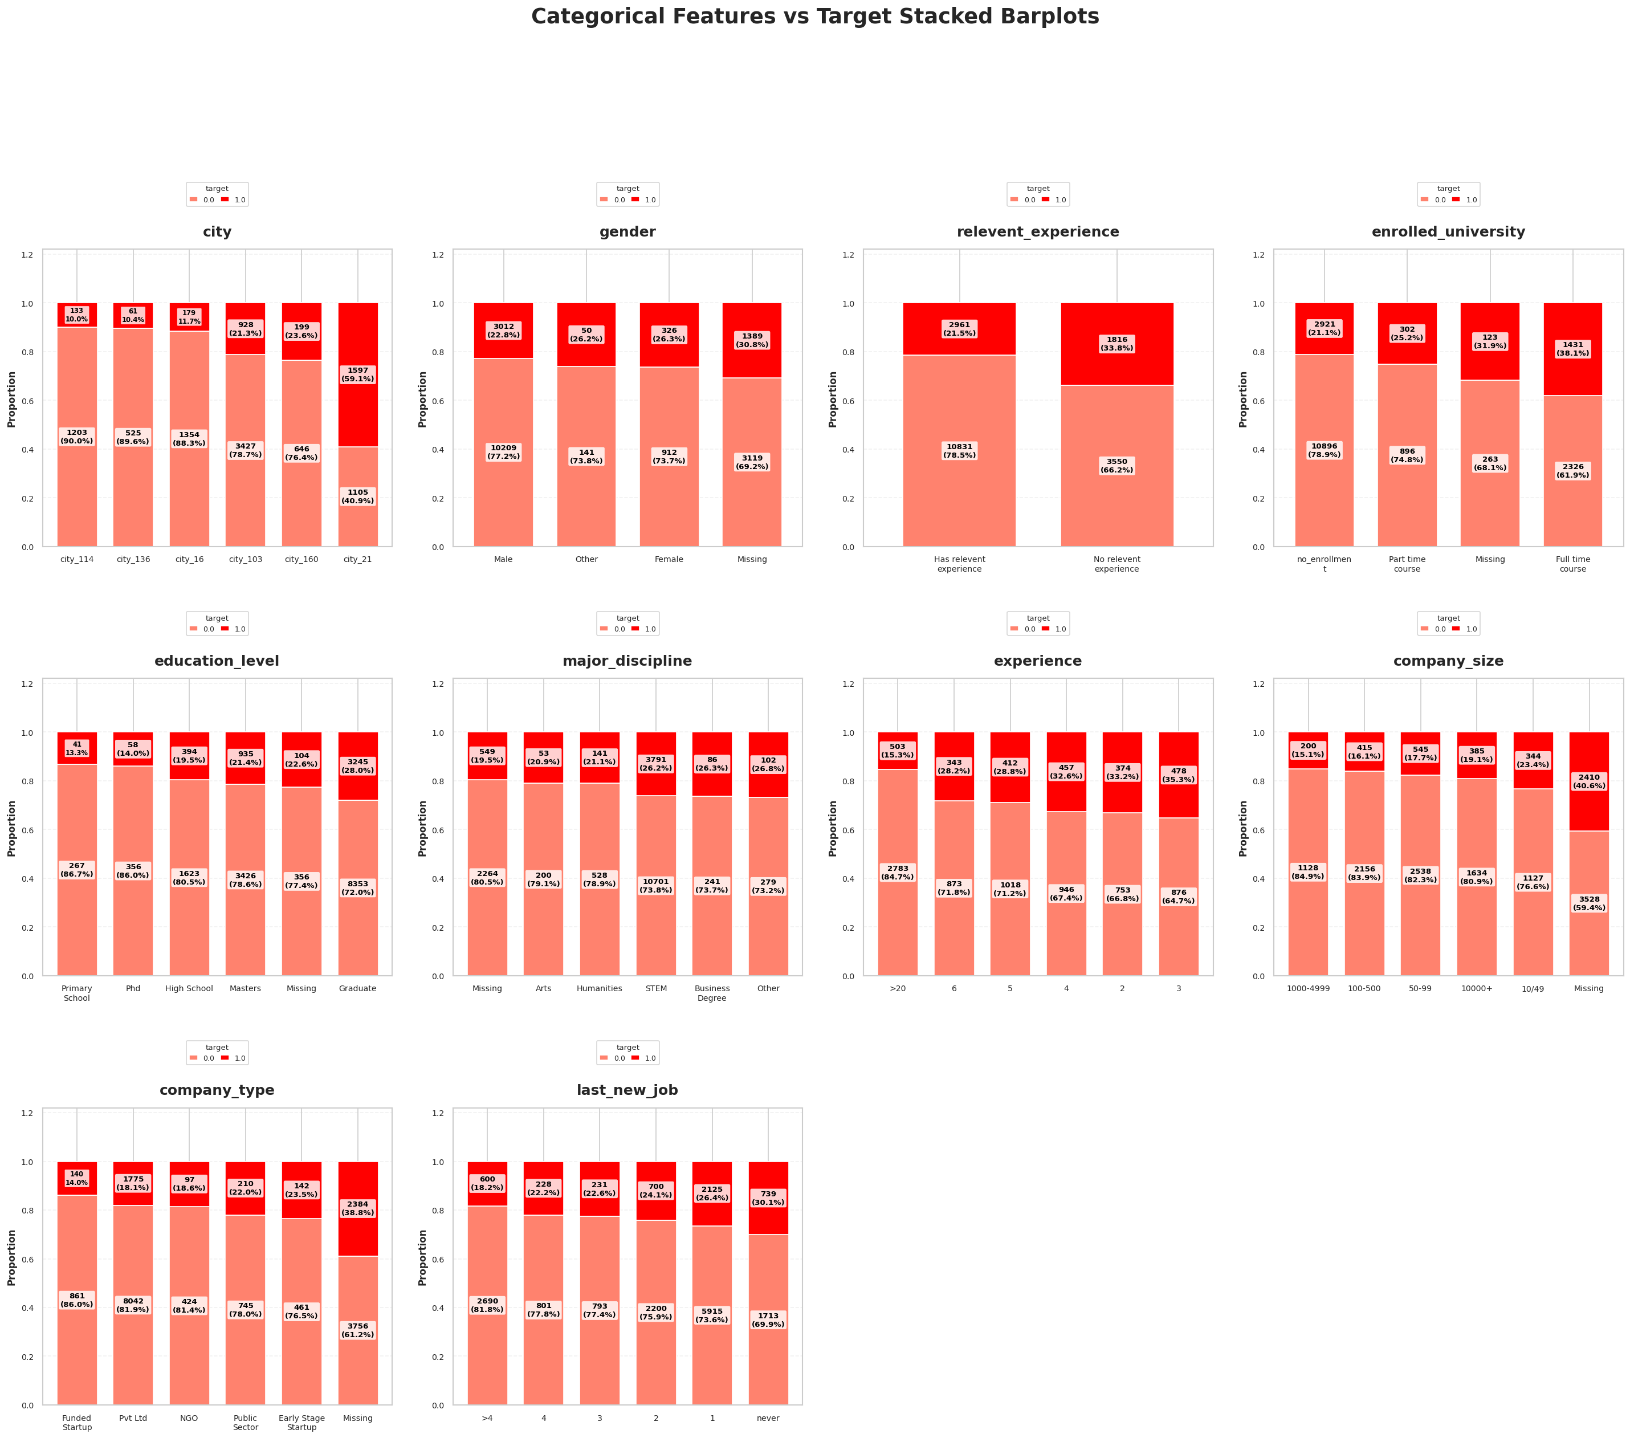
CATEGORICAL FEATURES VS TARGET
• Most categories show higher target = 0 → employees are generally stable
• City shows variation → some cities have higher job change (target = 1)
• No relevant experience → higher job change
• Full-time learners → more likely to change jobs
• Less experience → higher job change, more experience → stable
• Small companies/startups → higher job change than large companies
• Recent job change → higher chance of switching again
• Target helps compare categories, enrollee_id excluded (only ID)

Slide 13
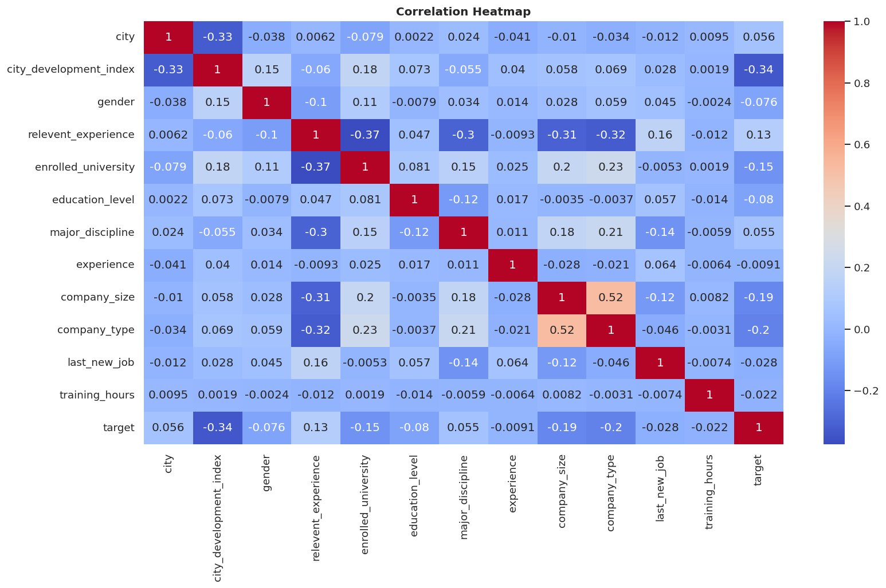
CORRELATION HEATMAP
• Heatmap shows relationships between all features (red = positive, blue = negative)
• Most features have weak correlation with target → no single strong predictor
• City Development Index has moderate negative correlation with target (-0.34)
• Company Size and Company Type show positive correlation (0.52)
• Other features show very low correlation → limited direct impact

Slide 14

PREPROCESSING
Irrelevant Feature Removal: The enrollee_id column is removed as it is only an identifier and does not contribute to prediction.
• Missing Value Treatment: Missing values are present in features like gender, company_size, and company_type, and are handled appropriately during preprocessing.
• Outlier Treatment: Outliers in numerical features (city_development_index, training_hours) are detected using the IQR method and treated using transformation techniques.
• Categorical Encoding: One-Hot Encoding is applied to categorical variables, increasing the dataset size to 185 features.
• Feature Scaling: Scaling is applied for algorithms like Logistic Regression to ensure better model performance.

Slide 15

FEATURE ENGINEERING
Feature engineering means creating better features from existing data to improve model performance
• Raw data is cleaned and transformed into useful formats (like experience and last job values)
• Some variables are grouped into categories (training hours, city development, etc.)
• Missing value flags are added to keep important missing information
• New features are created by combining existing ones to capture better relationships
• Dataset increased to 23 columns → 22 features (X) and 1 target (Y)
• Target is imbalanced → more 0 (14381) than 1 (4777)

Slide 16

TRAIN TEST SPLIT
• Data Splitting: Divided into 80% Training (15,326 rows) and 20% Testing (3,832 rows)
• Stratification: Ensured consistent target distribution across both datasets
• Target Distribution (Train): Class 0 → 11,504 | Class 1 → 3,822
• Target Distribution (Test): Class 0 → 2,877 | Class 1 → 955
• Input Features (X): 22 variables used for prediction
• Target Variable (Y): Binary classification for Job Change (0 / 1)
• Column Types: 8 Numerical and 14 Categorical features
• Missing Values: Fully handled with no missing data remaining
• Skewness Handling: Transformed skewed features like training_hours
• Encoding: Categorical features expanded to 226 columns
• Feature Scaling: Applied to improve Logistic Regression performance

Slide 17
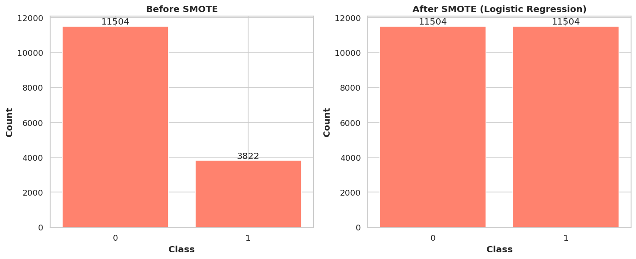
HANDLING IMBALANCED DATA (SMOTE)
• SMOTE (Synthetic Minority Over-sampling Technique) is used when the dataset is imbalanced
• It works by generating new samples between existing minority points
• This helps the model learn both classes equally and avoids bias
• Before SMOTE: Data is imbalanced → 0 = 11504, 1 = 3822
• Minority class has fewer samples → risk of biased model
• SMOTE generates synthetic samples for minority class (1)
• After SMOTE: Data becomes balanced → 0 = 11504, 1 = 11504

Slide 18

MODEL SELECTION AND EVALUATION
• Evaluate various classification algorithms including Logistic Regression, Random Forest, XGBoost, and LightGBM for predicting job change
• Logistic Regression is used for binary classification → simple, interpretable, and provides probability-based predictions.
• Random Forest is an ensemble model → handles complex data well and captures non-linear relationships effectively.
• XGBoost is an advanced boosting algorithm → delivers high accuracy and strong predictive performance.
• LightGBM is a fast-boosting model → efficient for large datasets and high-dimensional features.

Slide 19
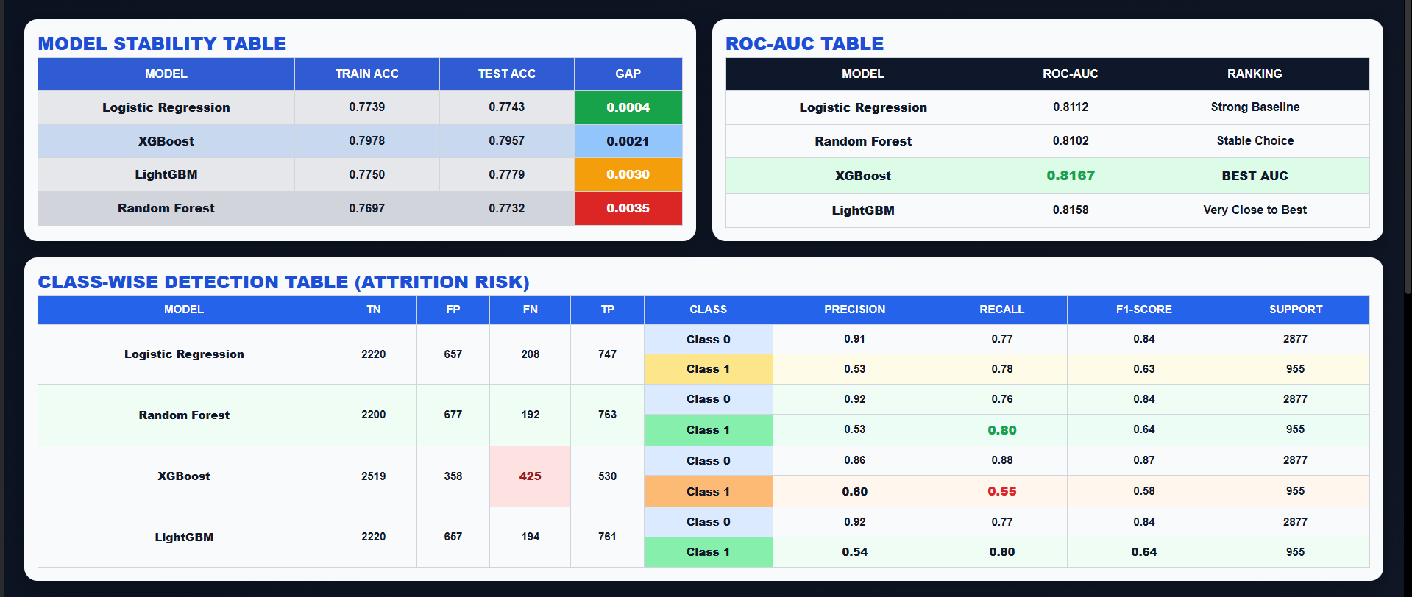
• Logistic Regression is stable → very small train-test gap (good baseline model)
• Random Forest shows higher recall (~0.80) → effective for detecting at-risk employees
• LightGBM also provides high recall (~0.80) → strong performance close to Random Forest
• XGBoost is the best model → highest ROC-AUC (0.8167) and best test accuracy (~0.7957), giving the best overall balance

Slide 20
PREDICTION, CONCLUSION & FUTURE RESEARCH
1. PREDICTION
• The model predicts the probability of a Data Scientist seeking a job change
• XGBoost is used for prediction → provides accurate and reliable results
• Helps identify high-risk employees in advance
2.CONCLUSION
• The project goal is achieved → successful job change prediction model built
• XGBoost performs best → highest accuracy and ROC-AUC score
• Model supports better decision-making in HR and workforce planning
3. FUTURE RESEARCH
Future research should focus on improving model accuracy and robustness by handling missing values, outliers, and class imbalance. Using advanced techniques and real-time data can further enhance prediction performance and practical use.

